Slide 1


SOCIAL MEDIA PROPOSAL
Developing a Social Media platform is just as important for Veri Peri, as a website.

Slide 2


Strategy for Facebook & Instagram
MAP.DESIGN.POSITION

Slide 3



Goals
1
2
3
Establish a strong Social Media presence
-Increase number of likes/Followers
-Increase audience engagement
Raise awareness of our restaurant’s Uniqueness.
Highlight the Key factors that make us different from others:
a) Fresh Chicken available (not frozen)
b) Home-grown
c) Authentic Protégées Cuisine
Reach out to bloggers/customers to visit our restaurant (particularly at the Opening)
MAP.DESIGN.POSITION

Slide 4
Themes & Ideas
“Fresh From the Farm:” highlighting that we use fresh chicken (not frozen) in all of our dishes
“Authentic Flavors of Portugal:” Sharing some “secret” recipes/ ingredients of some of our special dishes
3) “What is Your Heat Quotient?:” engaging the audience in competitions to determine how “hot” they can go!
MAP.DESIGN.POSITION

Slide 5

1) “Fresh from the Farm”
Option A)
Capture our expert Chefs preparing FRESH chicken on LIVE Webinar* (see below):
-Videos will be 2-3 minutes long- e.g.: how to prepare chicken for marinating
-Videos will be projected on-screen at the Launch for our customers to see how our chefs work/ what goes on In the Kitchen.
Notes:
*Webinar allows you to have live meetings, conferences and/or seminars that take place over the web. This app allows you to talk about new ideas, reach more people, as well as grow your business.
*To ensure that we have a wide audience watching us LIVE online,
we could pre-advertise it on Facebook so people tune in,
at the time when most fans are online.

Slide 6

Option B)

Slide 7

2) “Authentic Flavors of Portugal”
B) Create Video Blogs, capturing our expert Chefs on the following topics:
-tips relevant to food, home-grown/fresh chicken, general knowledge about food
-recipes of Veri Peri’s special dishes
-how to re-use leftover chicken from last night’s Veri Peri dinner (share recipes)
- LIVE Cooking sessions with the Chef
*Pre-advertise these V-logs on Facebook so people tune in LIVE to watch.
Notes:
Other ways that Veri Peri can can use LIVE Webinar app and link it to Facebook:
*Have a live Q and A session with our Facebook audience (introducing chefs/owner)
*Have a LIVE Session at the Launch, and ask our visitors what they think of the food, restaurant, ambiance, etc; record their reviews
(the visitors part of this video will naturally share it on their page, thereby multiplying reach of the video and raising awareness of our restaurant).

Slide 8

3) What is your Heat Quotient?
Organize an opening competition for Launch Date.
RULES:
1) Come to the Opening of Veri Peri
2) Try out any of our Chicken Platters with “Veri Hot” Shots
3) Take a picture with the dish.
4) Post on Social Media (Facebook and Instagram) and tag us using hashtag: “#MyHeatQuotient”
3) Whoever consumes the most “Veri Hot” Shots with their chicken wins a free couples dinner
How HOT
Can You Go?
#MyHeatQuotient

Slide 9

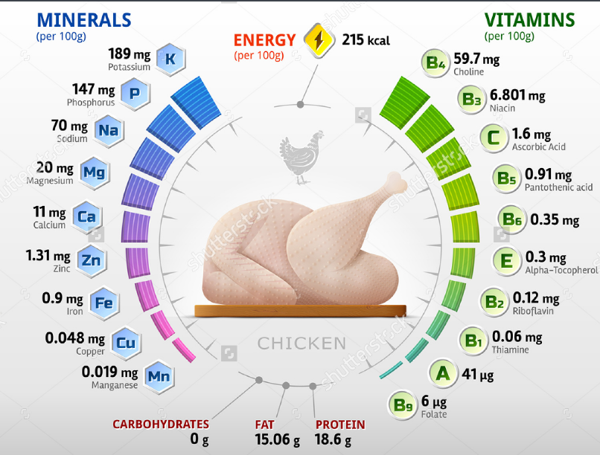
4) Mixed Content: adding “flavor” and value by sharing informative posts
Fun Facts: Nutritional Value of Chicken
Value-Addition Posts: Health Tips

Slide 10
Reaching Out to a Wider Audience
MAP.DESIGN.POSITION

Slide 11


-Reach out to Foodies/ Dubai-based Food Bloggers on different Food groups/forums on Facebook to spread awareness of our restaurant/ Opening Day
-Engage with and offer bloggers a free Couples Dinner in return of visiting us on Launch Date and writing a review on their blog.
(will be managed by YMS entirely)

Slide 12
Adding more “Life” & Taste on Instagram!
MAP.DESIGN.POSITION

Slide 13
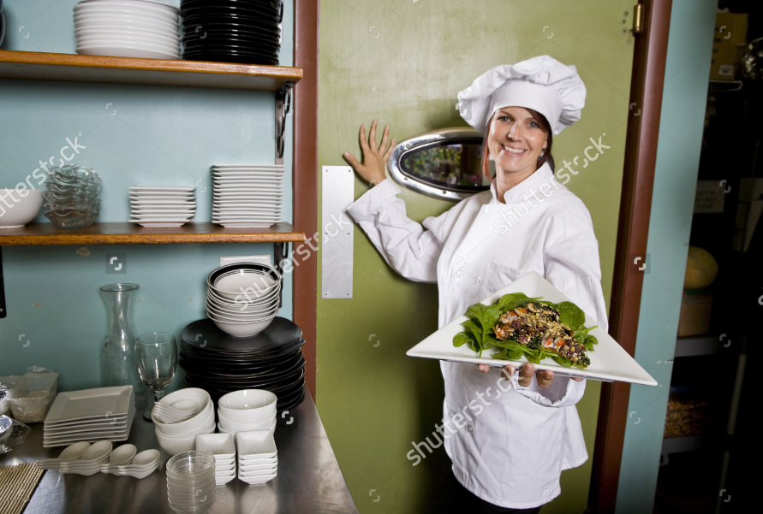
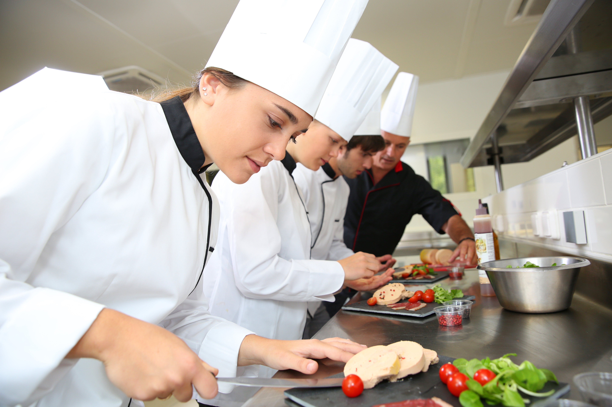
Strategy: In addition to sharing content derived from Facebook, Instagram must have additional “closer-to-life” and personal images; capture and share special moments, discoveries, inspirations that portray us as the “Veri Peri” family
“Chef Lisa presenting her masterpiece,
ready to be served!”
“BTS of Veri Peri: Preparing the best FRESH Chicken In town, just for you!”
MAP.DESIGN.POSITION

Slide 14
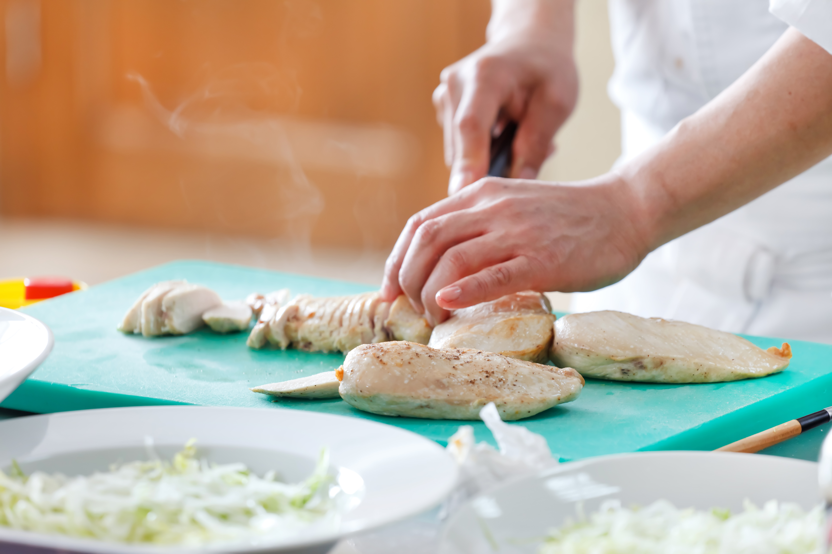
“Yes! It tastes just as good and fresh as it looks!”
Hashtags for Instagram: #Chicken #fresh #Beef #Grilled #Yummy #hungry #UAE #chef #restaurants #UAEFood #MyDubai #DubaiLife #foodindubai #dubaifoodies #foodie #dubaifoodbloggers #photooftheday #hungryforlife #Dubai #foodporn #VeriPeri #Protégées #cuisine
MAP.DESIGN.POSITION

Slide 15



Competitors’ Analysis
MAP.DESIGN.POSITION

Slide 16
Nandos
www.facebook.com/nandosuae
Strengths:
-Frequent Updates
-Competitions
-Consistency in Design elements
Weaknesses:
-Food photography could be improved
-Design is weak: image should be kept separate from text
-No Mixed Content: could add more fun food facts/informative posts
MAP.DESIGN.POSITION

Slide 17
TGI Friday’s
https://www.facebook.com/TGIFMiddleEast/
Strengths:
-Frequent Updates
-Posts Translated in Arabic
-Alluring food photographs/ videos
-Competitions (with exclusive prizes)
-posts are relevant to Current Affairs (i.e.: cricket matches)
Weaknesses:
-Design could be improved: simply added logo to some photographs (no captions)
-No Mixed Content: could add more fun food facts/informative posts
MAP.DESIGN.POSITION

Slide 18

Chilli’s
https://www.facebook.com/ChilisUAE/
Strengths:
-Frequent Updates
-Posts translated in Arabic
-Share mixed content: Quotes
-Creative food photography
-Engaging posts: Asking audience questions
Weaknesses:
-No Competitions for audience (improves engagement)
-Good photography, but no design element on page; could create some design templates
MAP.DESIGN.POSITION

Slide 19
Social Media Workflow
3rd Month- Future Plans
Product/ Brand Focused
What makes our brand different?
-Highlight Uniqueness of our brand: what makes us stand out from others/ our competitors.
2nd Month
3rd-4th Week:
Client Interaction
-Developing/Re-shaping content
-Reviewing what Campaigns work best
-What needs to be changed?
Create Presence on Social Media:
-Facebook
-Instagram
Goals:
*Increase likes/followers
*Awareness of Veri Peri across Dubai
*Engagement of audience
*reaching out to wider audience (for the Launch Date)
1st-2nd Week:
Strategy Development:
-Development of Content and pages. Testing out messages.
MAP.DESIGN.POSITION

Slide 20


