Slide 1

Digital Plan
3M – Auto care Products
Client: Golden Pearl Cleansing Lotion
Ref: Media Strategy
Date:16th January, 2018
Notes:
To change the image on this slide, select the picture and delete it. Then click the Pictures icon in the placeholder to insert your own image.

Slide 2
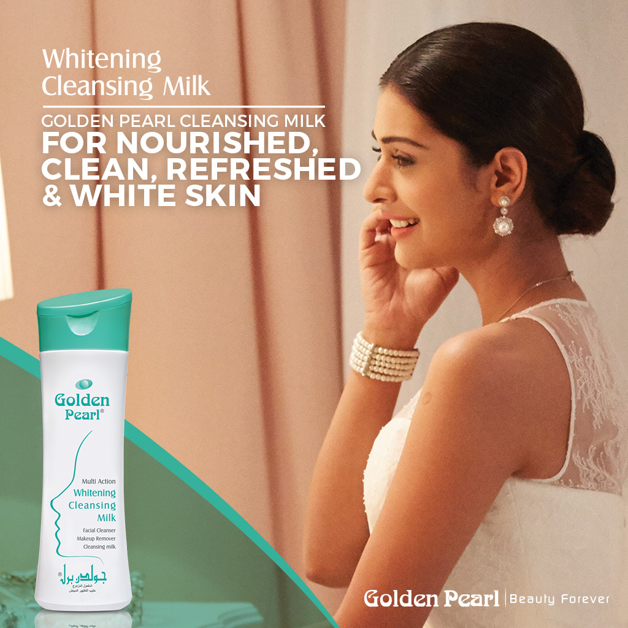
Add Golden Pearl Whitening Cleansing Milk to your daily routine and preserve your skin’s natural hydration by leaving it clean and supple!
For more information visit: http://goldenpearl.com.pk/

Slide 3
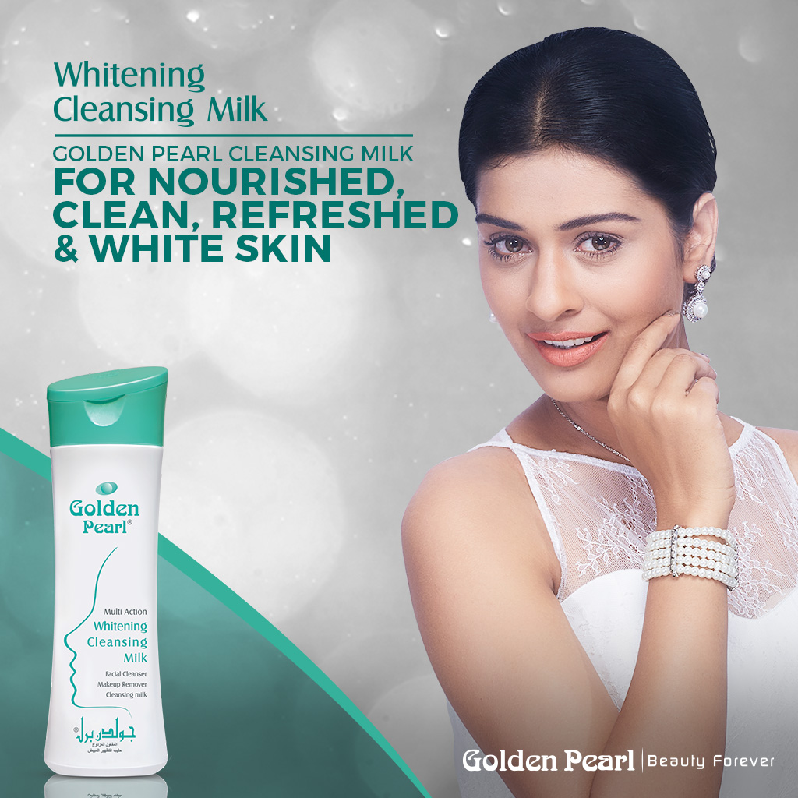
Make Golden Pearl Whitening Cleansing Milk part of your daily skincare routine, as it ensures clean, soft, supple and glowing skin with continuous use!
For more information visit: http://goldenpearl.com.pk/

Slide 4
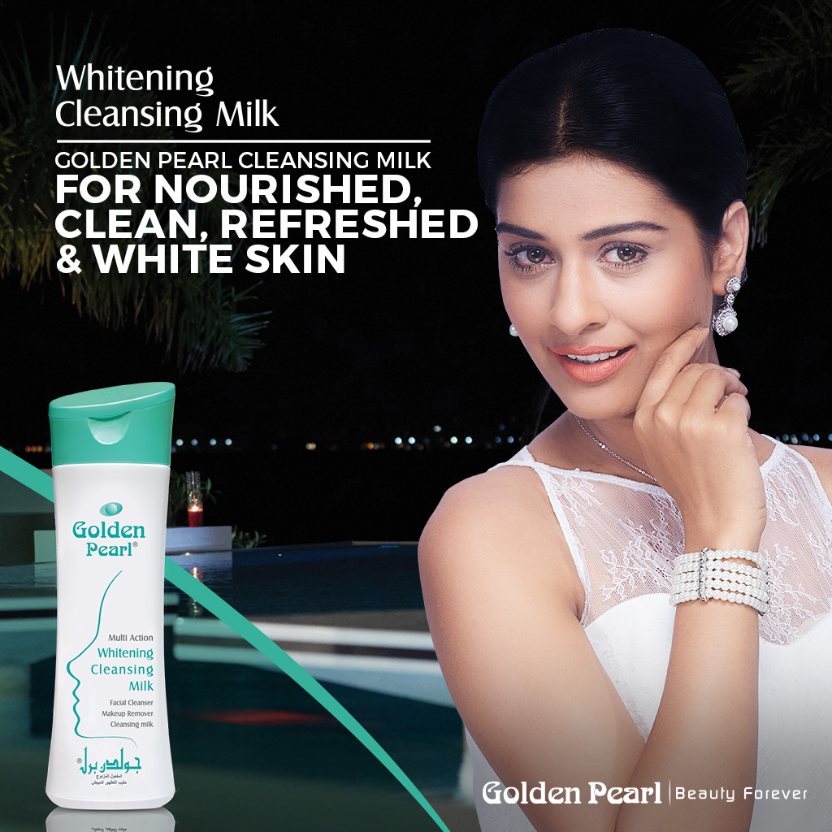
Whitening Cleansing Milk promises you impeccable beauty by preserving your skin’s natural softness and giving you an age-defying appearance.
For more information visit: http://goldenpearl.com.pk/

Slide 5
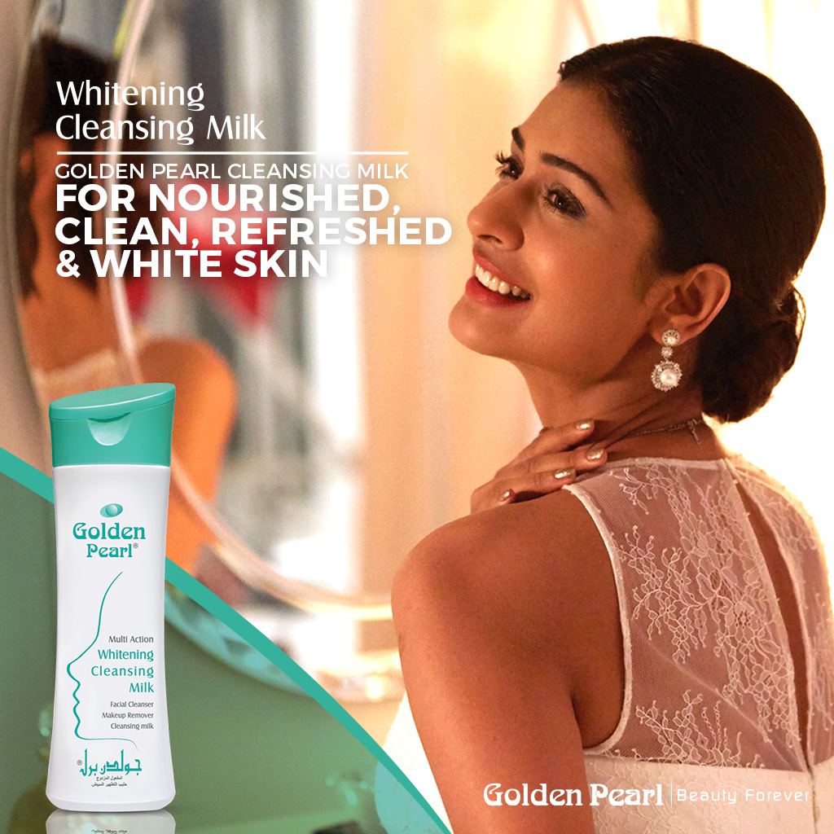
Golden Pearl Whitening Cleansing Milk cleans and restores your skin, giving you a flawless and bright glow that lasts without any extra effort!
For more information visit: http://goldenpearl.com.pk/

Slide 6
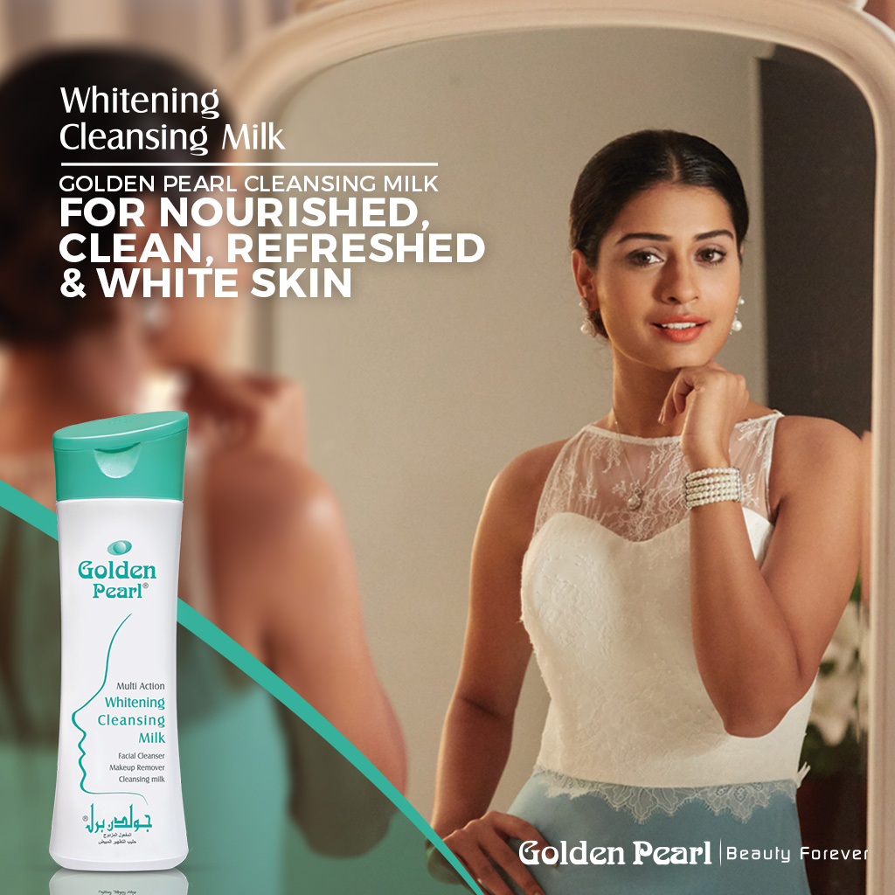
Golden Pearl Whitening Cleansing Milk helps to improve your appearance, resulting in fresh, moisturized and white skin that feels nourished and rejuvenated.
For more information visit: http://goldenpearl.com.pk/

